Slide 1
Why study evolution?
Best conceptual framework for understanding
origins of biodiversity
Adaptations that allow organisms to exploit their
environment
Self discovery
Keystone of biology (including human health)

Slide 2
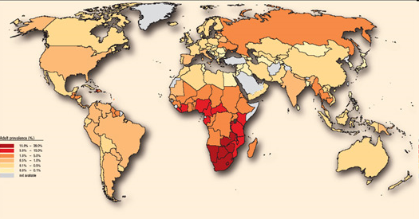
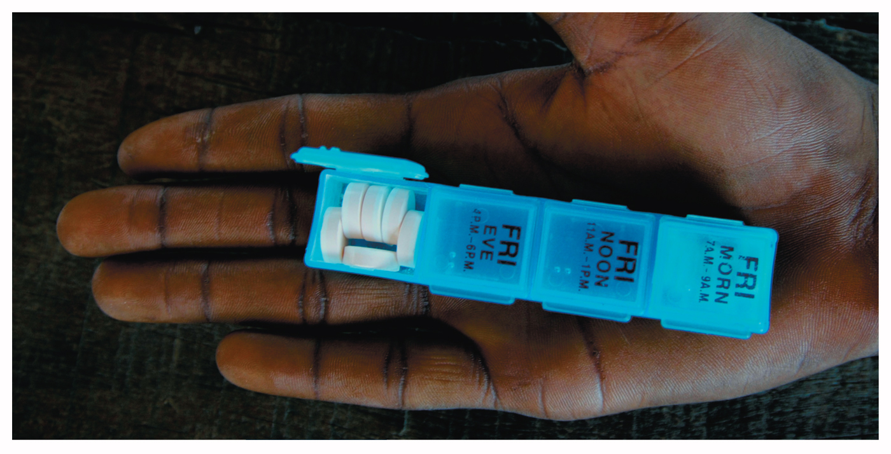
Lecture: HIV
Motivation
What can we learn when we apply evolutionary principles to our understanding of the
of the HIV epidemic?? Can we use HIV to introduce us to evolutionary principles
Natural Selection
Mutation
Gene Flow
Descent with Modification
Notes:
Chapter 1 Opener
Descent with modification, natural selection
Multi drug therapies
Cultural implications, for example in the US the use of condoms is controversial
AIDS: Acquired immune deficiency disease
HIV: Human immune deficiency virus

Slide 3
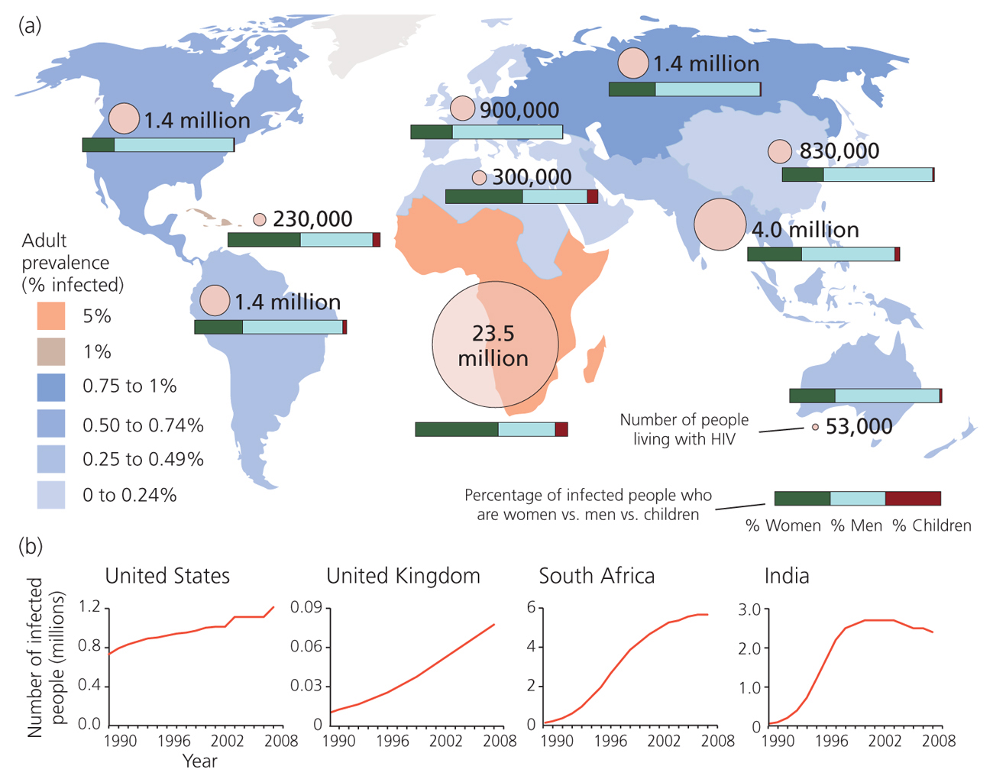
II. Prevalence & Effect

Slide 4
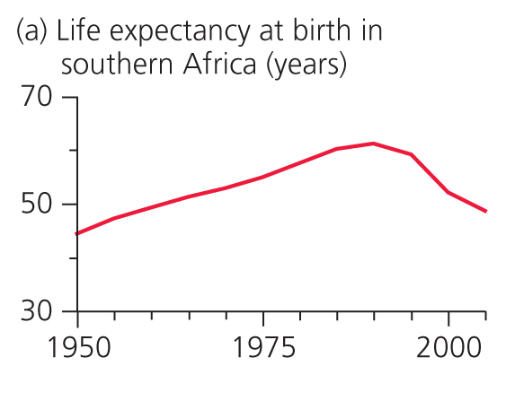
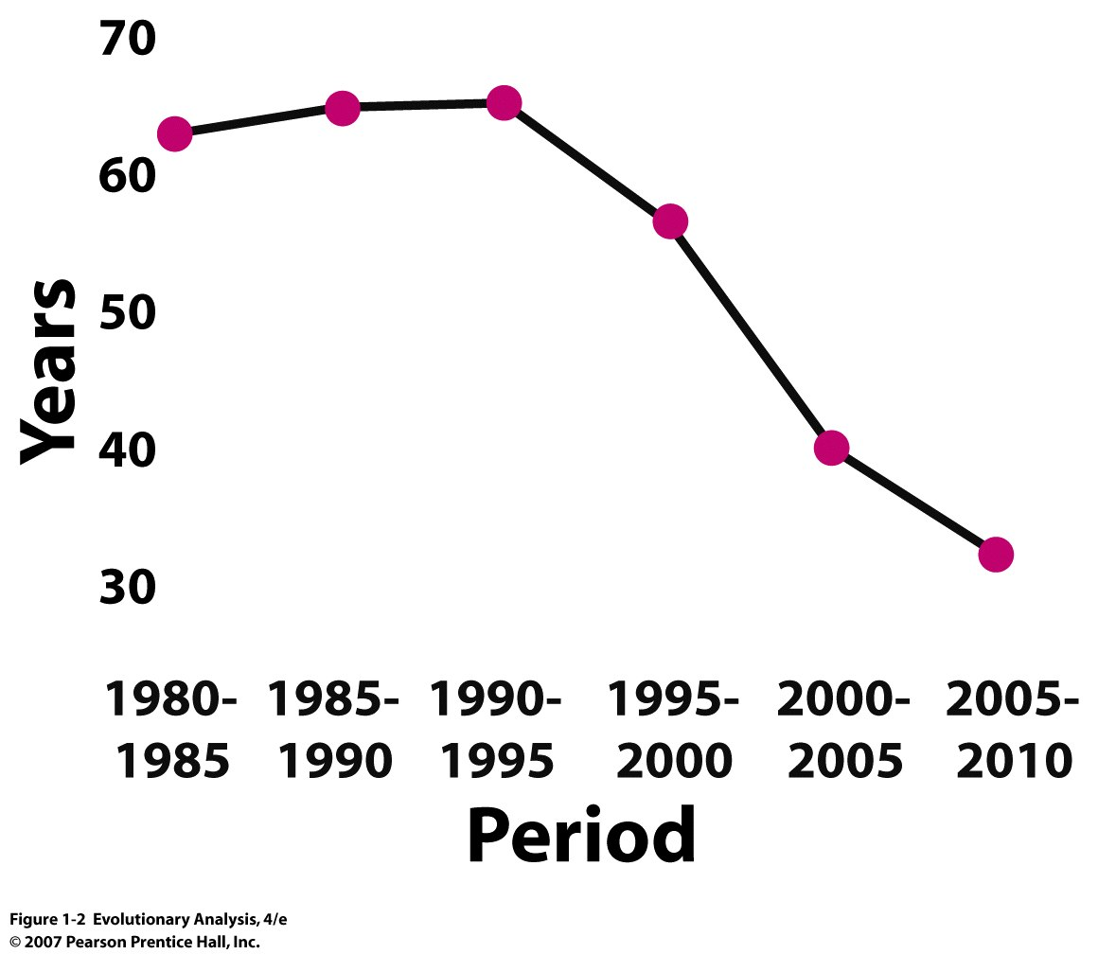
HIV is a natural selective
agent
Life expectancy in Botswana
Notes:
Figure 1.2 Life expectancy in Botswana
This graph shows the estimated life expectancy at birth for individuals born between 1980 and 2000, and projected life expectancy for individuals born between 2000 and 2010. The decline after 1990 is due to the AIDS epidemic. Redrawn from Figure 12 in UNAIDS (2004).
Discuss selective agent on: promiscuity, safe sex, abstinence, etc., if there is genetic variation for these behavioral traits then population may evolve.

Slide 5
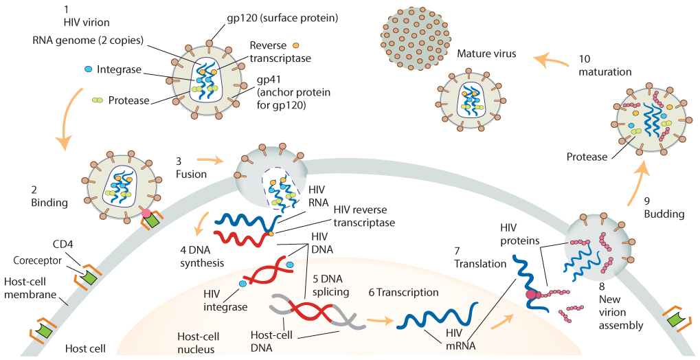
III. Basic Biology of HIV and Human Immunoresponse
Infectious stage
*
Reverse transcriptase
Helper T-cell
11. HIV replication = T-cell death
Notes:
Figure 1.5 The life cycle of HIV
An HIV virion (1) invades a host cell by binding to two proteins on the cell's surface (2), allowing the virion to spill its contents into the cell (3). Once inside the host cell, HIV's reverse transcriptase makes a DNA copy of the viral genome (4). HIV's integrase inserts this DNA copy into the host cell's genome (5).The host cell's RNA polymerase transcribes the viral genome into messenger RNA (6), and the host cell's ribosomes transcribe the viral mRNA into precursor proteins (7). HIV's protease cleaves the precursors, yielding mature viral proteins (8). New virions assemble in the host cell's cytoplasm (9), then bud from the host cell's membrane (10).
Reverse transcriptase is source of mutations, not as good as DNA polymerase in base pair recognition

Slide 6
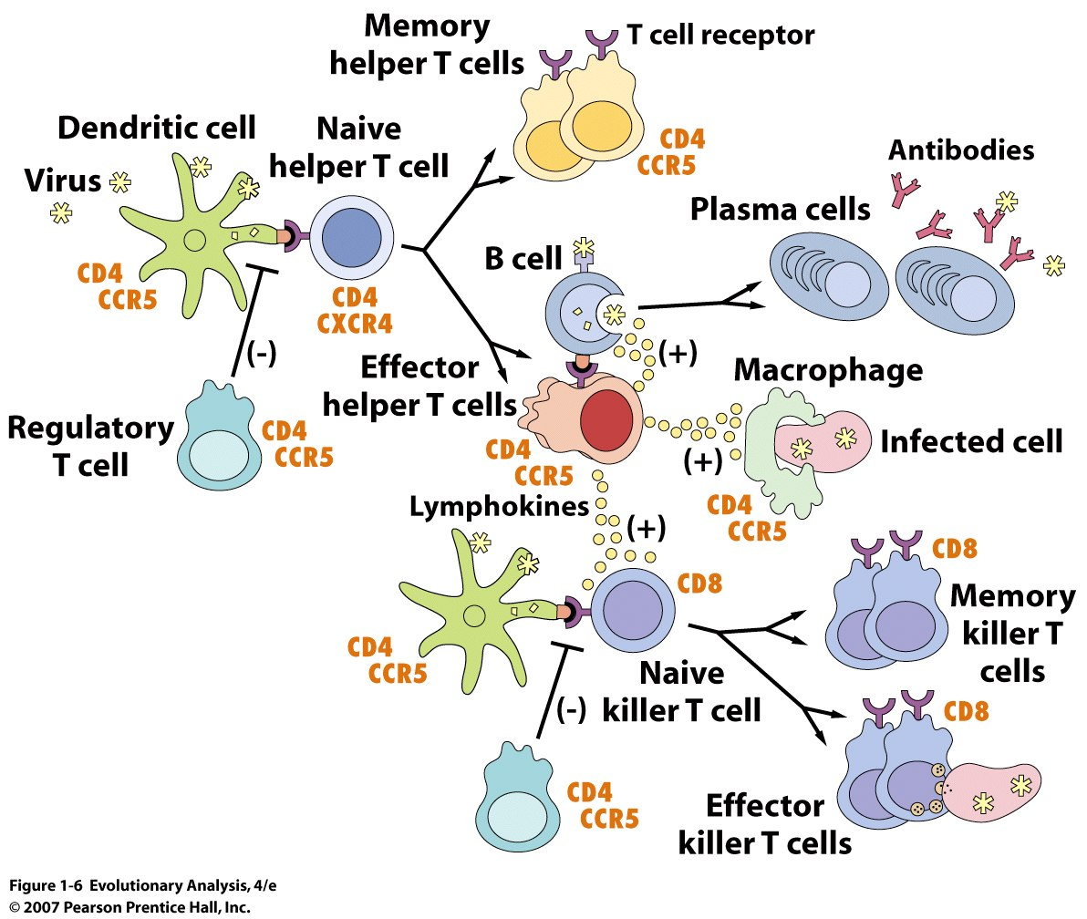
Notes:
Figure 1.6 How the immune system fights a viral infection
immune cell with threadlike tentacles called dendrites used to enmesh antigen, which they present to T cells = dendritic cells
CCR5 receptor important, it is a chemokine, which directs other cells
Dendritic cells (green) take up the virus and present bits of its proteins to naive helper T cells. Once activated by a bit of viral protein that fits its T cell receptor, a helper T cell divides to produce memory cells (yellow) and effector cells (red). Memory helper T cells sit out the current battle but remain ready to trigger a quick reaction should the same virus invade again. Effector helper T cells join the current fight. In part by releasing signalling molecules called chemokines, they stimulate B cells to mature into plasma cells that produce antibodies that bind the virus. Effector helper T cells also stimulate macrophages to ingest infected cells and help activate naive killer T cells. Activated killer T cells divide to produce memory cells and effector cells. Effector killer T cells identify and kill cells infected with the invading virus. The immune response is kept under control by regulatory T cells. The orange labels identify cell-surface proteins, some of which are exploited by HIV to gain entry into cells. Modified from NIAID (2003).
Note that during infection the HIV virus is evolving to escape detection by the immune system

Slide 7
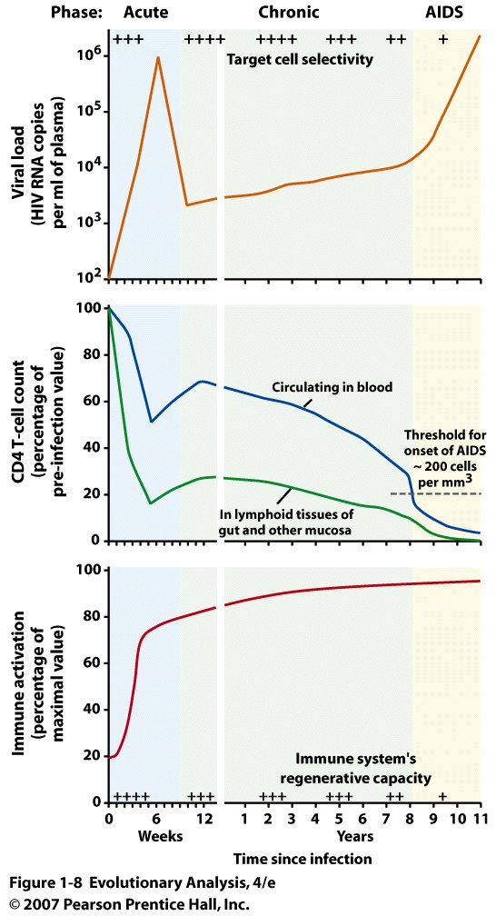
Notes:
Figure 1.8 The general pattern of progression of an untreated HIV infection
An untreated HIV infection typically has three phases: an acute phase, in which the host may show general symptoms of a viral infection; a chronic phase in which the host is largely asymptomatic; and an AIDS phase, in which the host's immune system collapses, leaving the host vulnerable to the opportunistic infections. The viral load (top) spikes during the acute phase, then falls as the host mobilizes an immune response. The immune response fails to halt viral replication, however, and during the acute and AIDS phases the viral load climbs again. Late in the infection, the viral population often evolves the capacity to infect a greater variety of host cells. The patient's CD4 T-cell counts (center) fall during the acute phase, then recover somewhat. During the chronic and AIDS phases, they fall again. The host's immune system remains highly activated (bottom) throughout. This may help fight the virus, but it also provides cells in which the virus can replicate and ultimately exhausts the immune system's capacity to regenerate. After Bartlett and Moore (1998), Brenchley et al. (2006), Grossman et al. (2006).

Slide 8
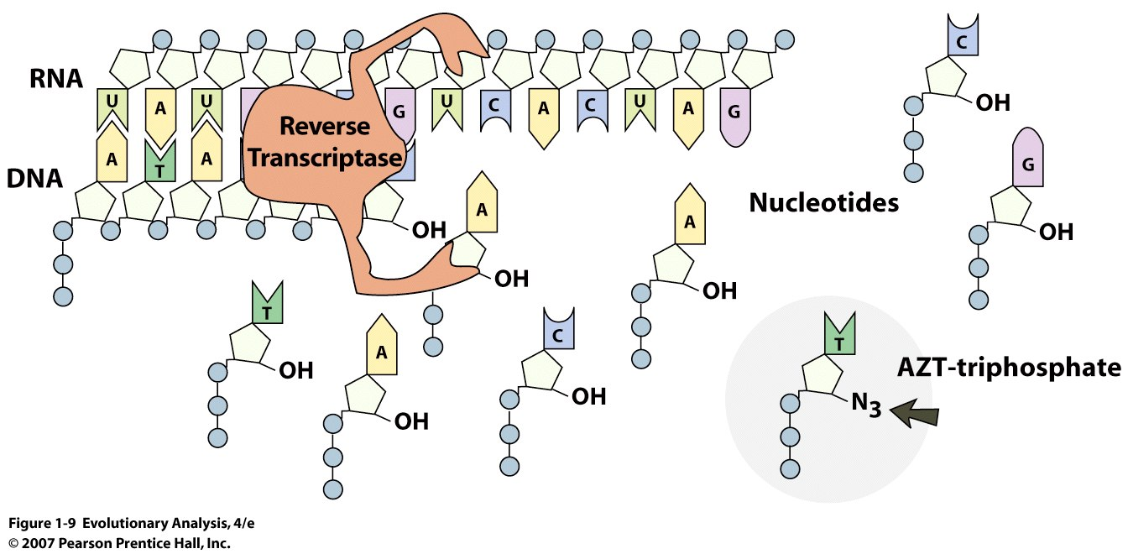
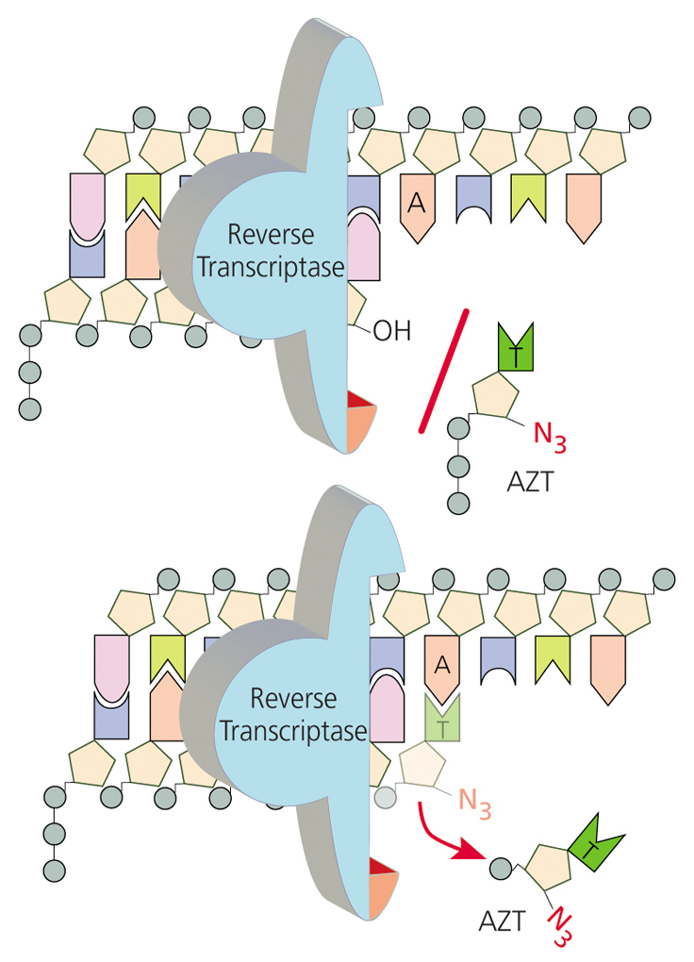
IV. HIV Treatment
How AZT blocks reverse transcriptase
Notes:
Figure 1.9 How AZT blocks reverse transcriptase,
HIV's reverse transcriptase enzyme uses nucleotides from the host cell to build a DNA strand complementary to the virus's RNA strand. AZT mimics a normal nucleotide well enough to fool reverse transcriptase, but it lacks the attachment site for the next nucleotide in the chain. Hydroxyl unit is missing
AZT can be incorporated into DNA by DNA polymerases, though less efficiently
AZT mimics thymidine Azido-Thymidine
Viruses utilize all of the basic cell machinery of their hosts and therefore are hard to control

Slide 9
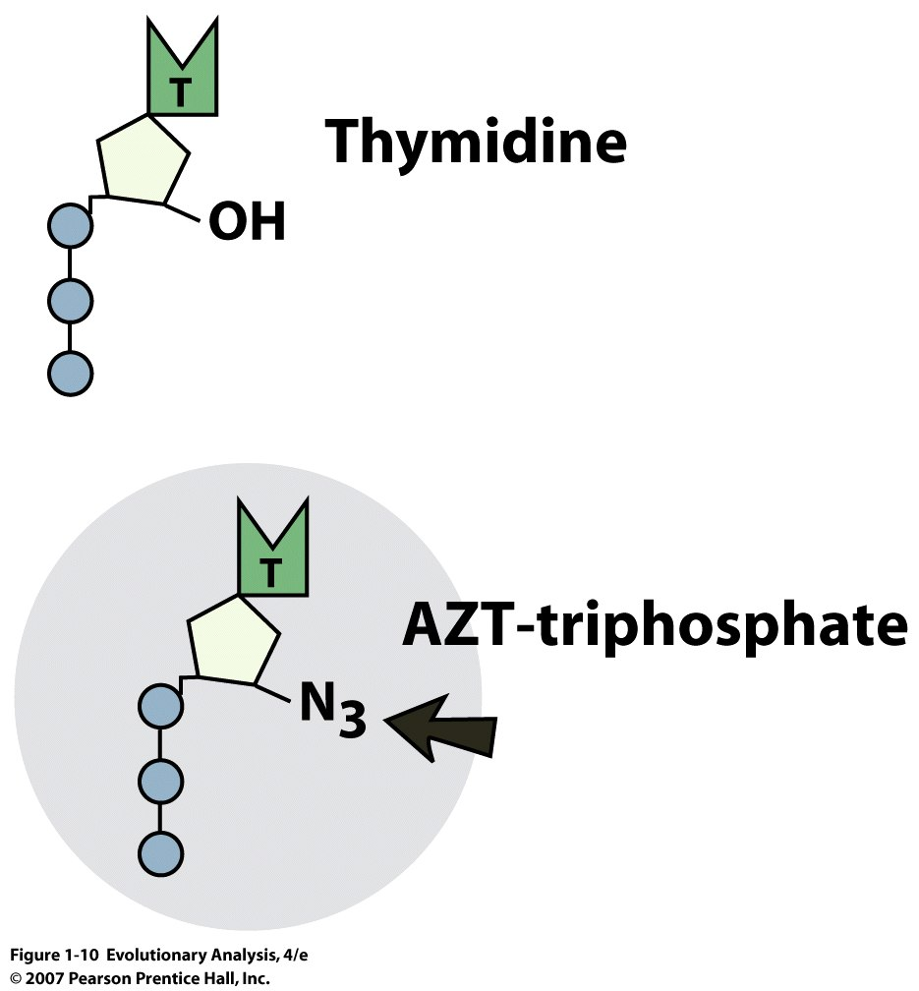
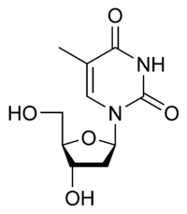
pyrimidine
Notes:
Figure 1.10 Thymidine versus AZT

Slide 10
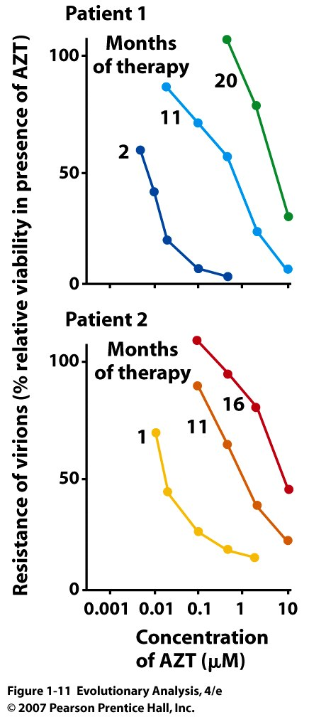
V. Evolution of HIV in Host
AZT is a selective agent
On HIV
Needed to prevent
replication in t-tubes
Notes:
Figure 1.11 HIV populations evolve resistance to AZT within individual patients, demonstration of natural selection, selective agent = AZT
Patient 1: sample virons at 2 months and conc of 1 AZT virons susceptible, but 11 months you needed 10 concentration
As therapy continued in these two patients, higher concentrations of AZT were required to curtail the replication of viruses sampled from the patients' blood. Redrawn from Larder et al. (1989).

Slide 11
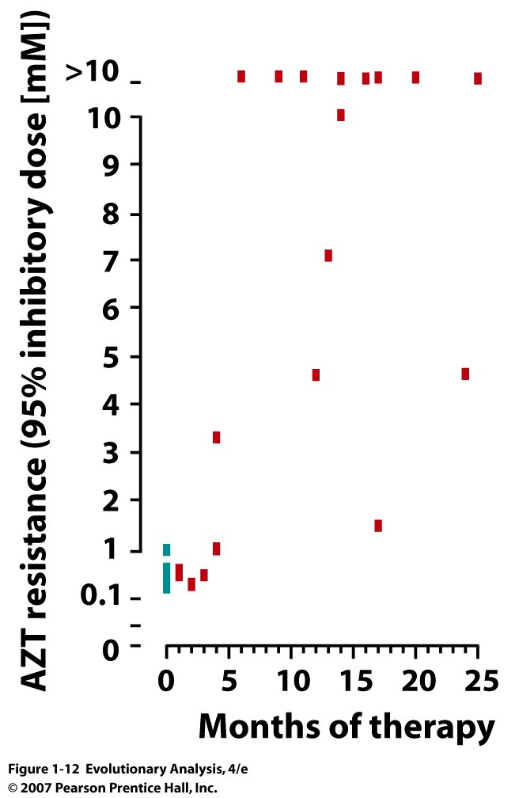
Notes:
Figure 1.12 In most patients, AZT resistance evolves within six months
This graph plots resistance in 39 patients checked at different times. Redrawn from Larder et al. (1989).
18 patients had no exposure (0 class)

Slide 12
Can we predict the changes in
Reverse Transcriptase* using evolutionary principles??
*due to AZT

Slide 13
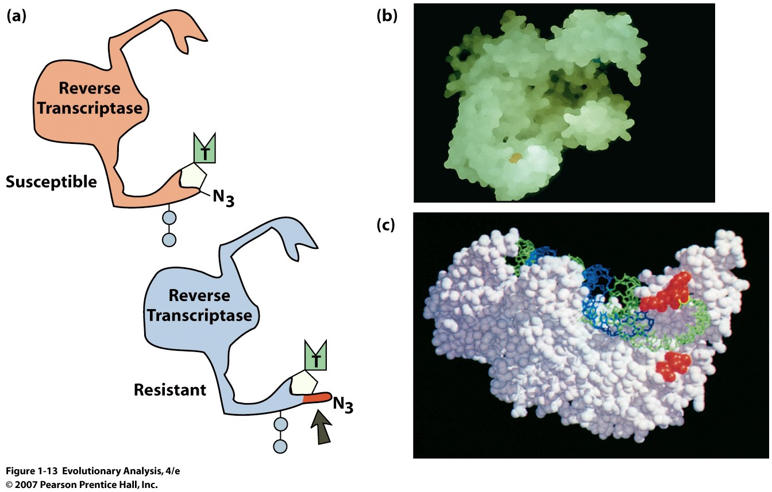
Notes:
Figure 1.13 The difference between AZT-sensitive versus AZT-resistant reverse transcriptases, what principle does this demonstrate, natural selection acts on random variation introduced by mutation. Computer algorithms driven by principles of natural selection.
(a) This cartoon shows how a change in reverse transcriptase's active site might enable it to recognize AZT as an imposter. (b) This image shows the large groove in the reverse transcriptase enzyme where the substrate (RNA) binds. (c) The red spheres on this image indicate the locations of amino acid substitutions correlated with resistance to AZT. Note that they are localized in the enzyme's groove, or active site. From Cohen (1993).

Slide 14
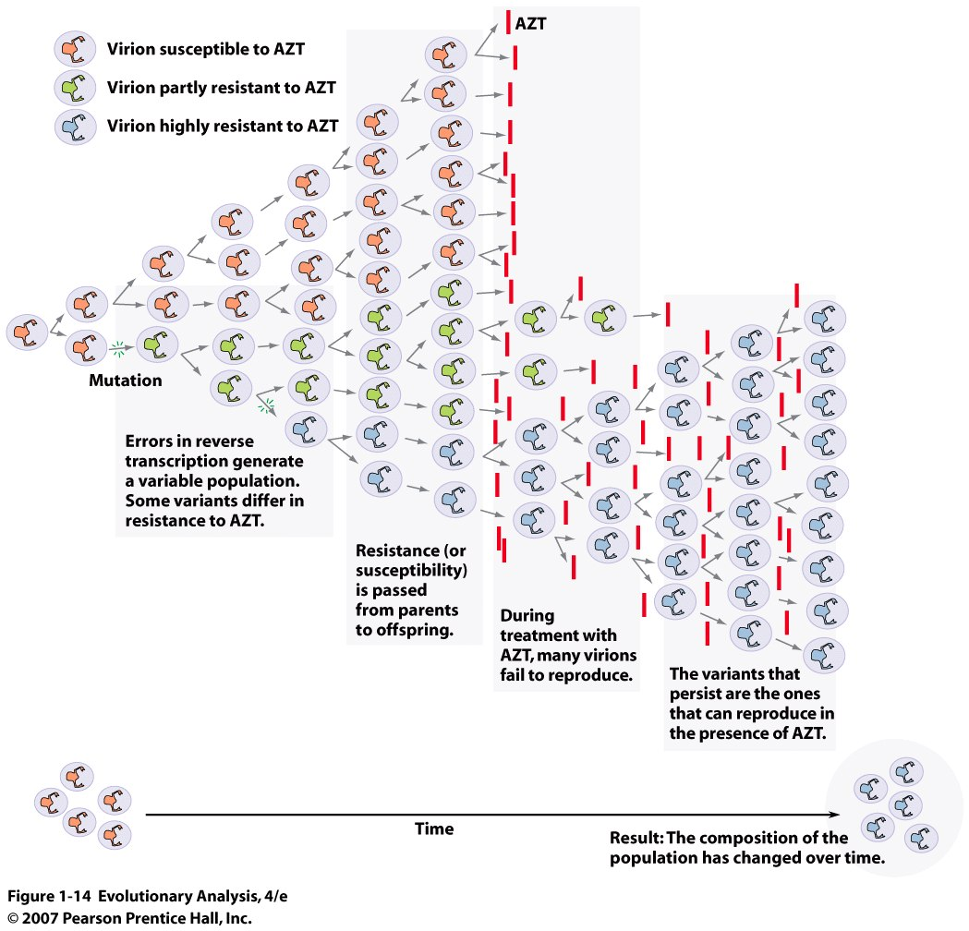
Notes:
Figure 1.14 How HIV populations evolve resistance to AZT
Variation due to mutation, inheritance, and differences in survival due to AZT results in a change in the composition of the population over time.

Slide 15
HIV Contributes to Collapse of Immune System in 3 Ways:
Continuous evolution of HIV proteins used by human
immune system to recognize HIV
2. Evolution towards more and more aggressive replication
3. HIV often evolve to infect different immune cells (naïve T cells)
using different immune cell receptor proteins

Slide 16
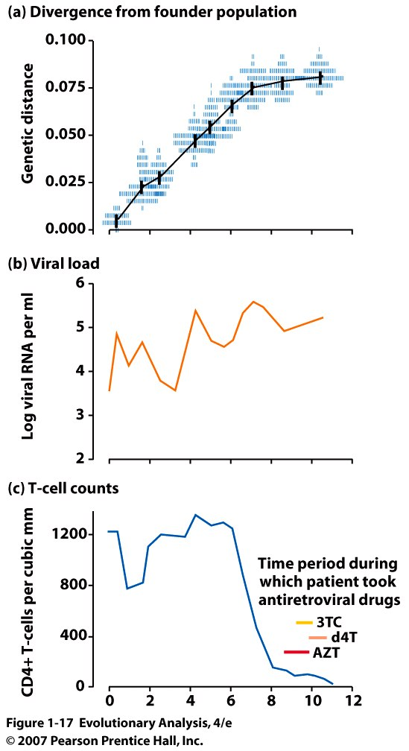
Evolution at gp120 locus
Years since patient became HIV Positive
Notes:
Figure 1.17 Evolution of the HIV population within an individual patient
Each blue tick represents a virion sampled from the patient during the course of the infection; its horizontal position indicates when it was sampled, and its vertical position indicates how genetically different it was from the first sample. The black line shows the trend: Virions sampled later had diverged more. (b) The patient's viral load increased over time. (c) The patient's CD4 T-cell count stayed fairly high for several years, then dropped precipitously. From Shankarappa et al. (1999).

Slide 17
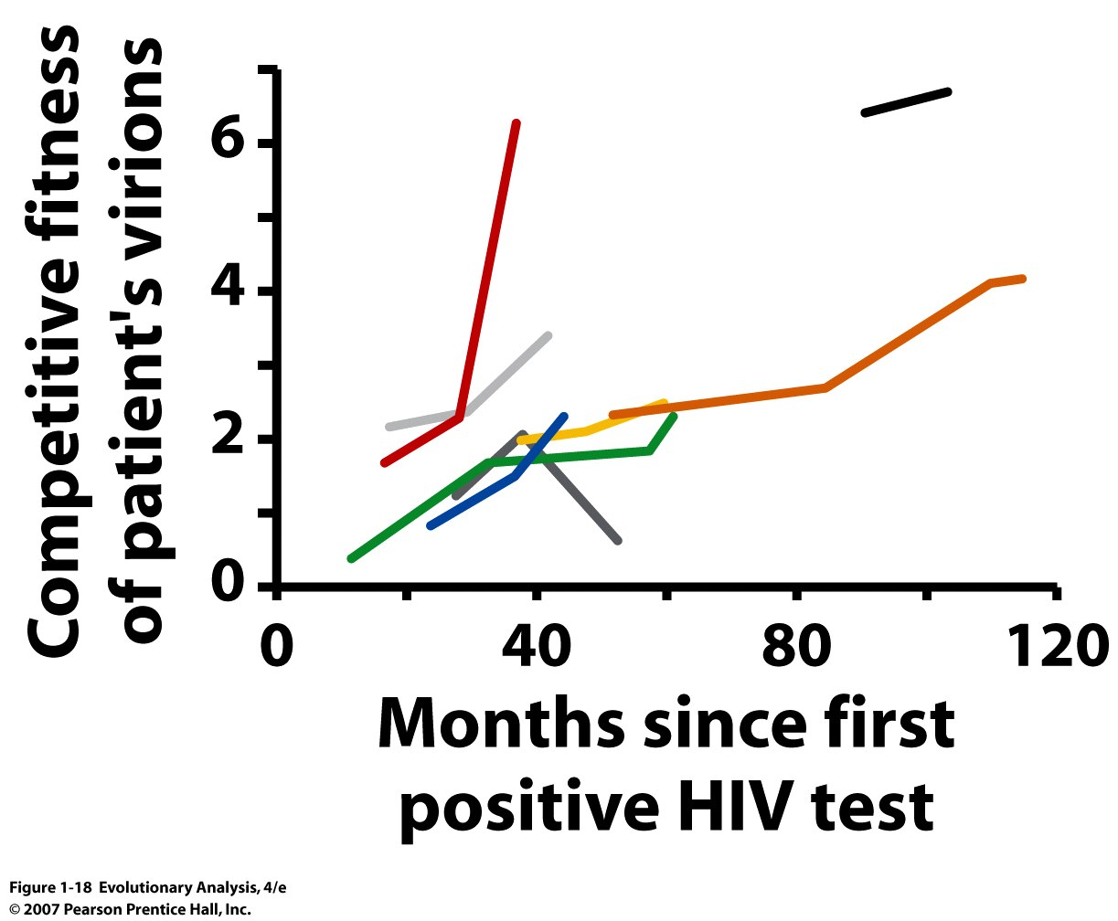
HIV strains evolve to become more competitive with other viruses
Notes:
Two levels of selection:
1: Within host
2: To get to new hosts
Figure 1.18 HIV populations in most hosts evolve toward more aggressive replication
Each color represents sequentially sampled virions from a particular host. Competitive fitness reflects the virions' ability to replicate in white blood cells from an uninfected donor in the presence of control strains. In seven of eight patients, the HIV population's ability to persist in the fact of competition increased over time. Rerendered from Troyer et al. (2005).
You have to stick to the prescription schedule

Slide 18
HIV evolves to recognize the CXCR4 receptor on Naïve helper T cells
Notes:
CXCR4 is the receptor on naïve helper T cells and the virus evolves to recognize this as well

Slide 19
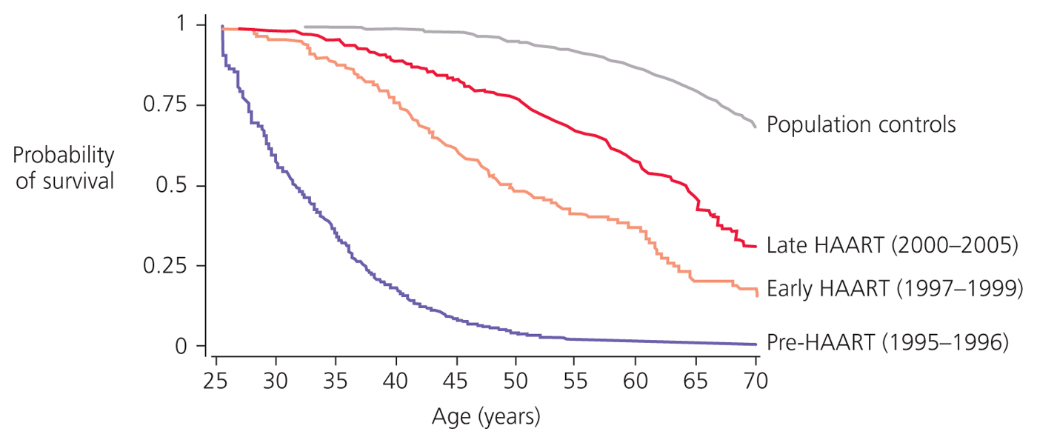
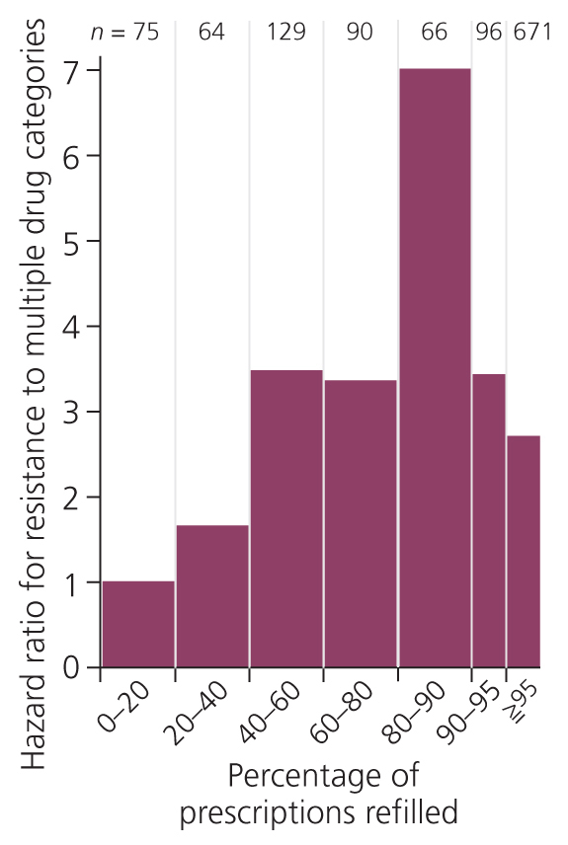
What therapy is there for a continuously evolving disease??
A therapy that requires HIV to evolve
at many sequences through many
mutations
Notes:
HAART, Highly Active Treatments, Cocktails, survivorship, general population, Denmark
Low, no evolution
intermediate, evolution
high, eventual evolution

Slide 20
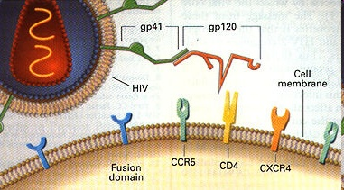
VI. Evolution of the Host, Evidence for Genetic Variation for Resistance
HIV-1 interacts with a cell-surface receptor, primarily CD4, and through conformational changes becomes more closely associated with the cell through interactions with other cell-surface molecules, such as the chemokine receptors CXCR4 and CCR5.
Notes:
Chemokines are a family of small cytokines, or proteins secreted by cells. Proteins are classified as chemokines according to shared structural characteristics such as small size (they are all approximately 8-10 kilodaltons in size), and the presence of four cysteine residues in conserved locations that are key to forming their 3-dimensional shape. Their name is derived from their ability to induce directed chemotaxis in nearby responsive cells; they are chemotactic cytokines. However, these proteins have historically been known under several other names including the SIS family of cytokines, SIG family of cytokines, SCY family of cytokines, Platelet factor-4 superfamily or intercrines. Some chemokines are considered pro-inflammatory and can be induced during an immune response to promote cells of the immune system to a site of infection, while others are considered homeostatic and are involved in controlling the migration of cells during normal processes of tissue maintenance or development. Chemokines are found in all vertebrates, some viruses and some bacteria, but none have been described for other invertebrates. These proteins exert their biological effects by interacting with G protein-linked transmembrane receptors called chemokine receptors, that are selectively found on the surfaces of their target cells (Wilkipedia )

Slide 21
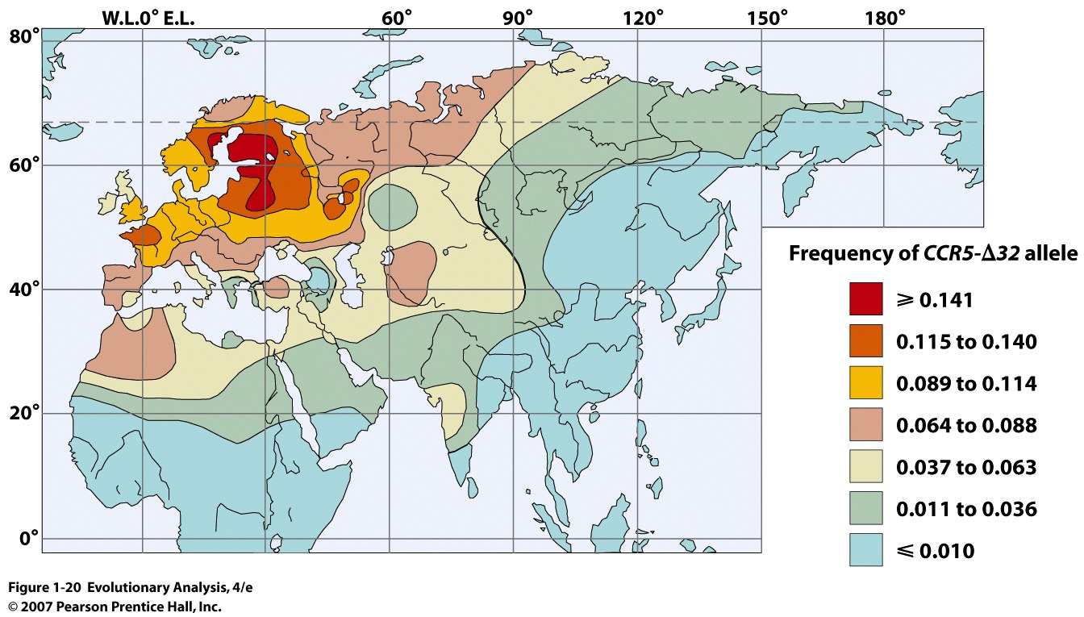
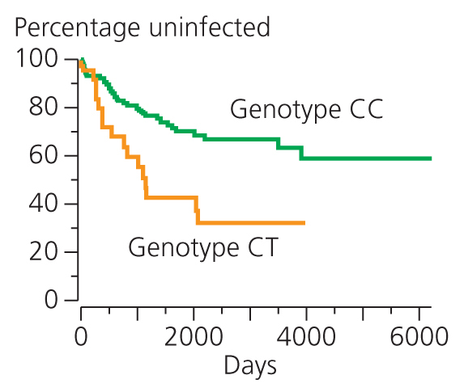
Two loci in human populations confer resistance to HIV
Deletion in CCR5 locus
Genetic variation
In Africa for
Resistance to HIV
Sex workers in Kenya having a C instead of a T at position 868 for CD4 have resistance to HIV
Notes:
Figure 1.20 The frequency of the CCR5-Δ32 allele in the Old World
The Δ32 allele is at highest frequency in northern Europe. From there its frequency declines to the south and to the east. From Limborskaa et al. (2002).
Heterozygous you are immune for about 2 years, homozygous immune forever
Retrocyclin, non functional in gorillas , chimps and humans, loss of function mutations, stop codon, could increase resistance but no humans found with reverse mutation

Slide 22
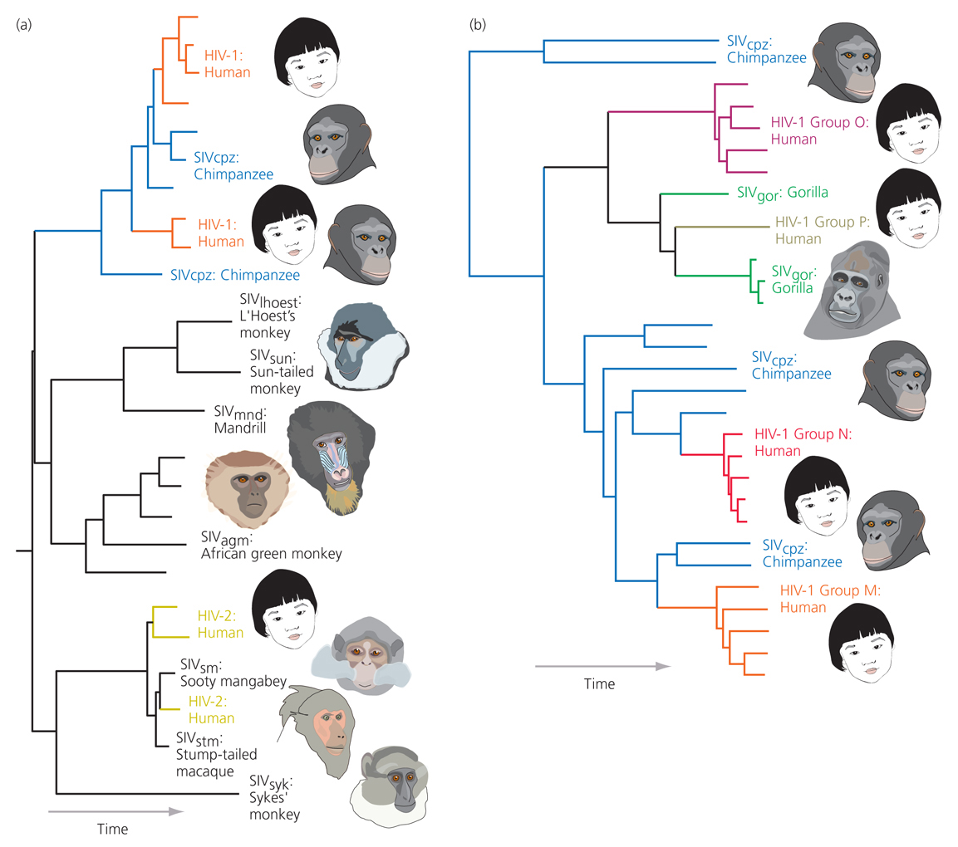
VII. Evolution of Human Specific HIV
Multiple evolution of HIV
Notes:
Multiple origins (reverse transcriptase) (A)
Multiple origins (used envelope proteins) (B)
Consequences for Vaccine Development
Figure 1.21 The family tree of HIV and related viruses
This tree shows the evolutionary relationships among the two major forms of HIV, called HIV-1 and HIV-2, and the immunodeficiency viruses that afflict nonhuman primates. Note that the viruses that branch off near the orange arrow at the base of the tree parasitize monkeys. Based on this observation, researchers conclude that virus strains jumped from monkeys to humans. (b) This tree shows a more detailed analysis performed by Hahn et al. (2000). (The asterisk marks the same branch point on both trees.) The arrows indicate the places on the tree where immunodeficiency viruses were transmitted from chimpanzees to humans. According to this tree, each major strain of HIV-1 originated in a different transmission event from a chimpanzee host, as represented by the gray arrows. Redrawn from Hahn et al. (2000).
2 events of crossing over to humans HIV I and HIV II
HIV is an abbreviation for Human Immunodeficiency Virus. There are two main forms of HIV: HIV-1 and HIV-2. HIV-1 was discovered by Luc Montagnier and his associates at the Institute Pasteur in Paris in 1983. HIV-2 was first identified among patients in Cameroon in 1985. HIV-2 is more similar to SIV (Simian Immunodeficiency Virus) than is HIV-1 and it is much less virulent (usually not resulting in full blown AIDS, but still fatal). [It is also rarer in this country. As of 01/01/00, there were a total of only 94 cases recorded, 66 of which were born in west Africa.].

Slide 23
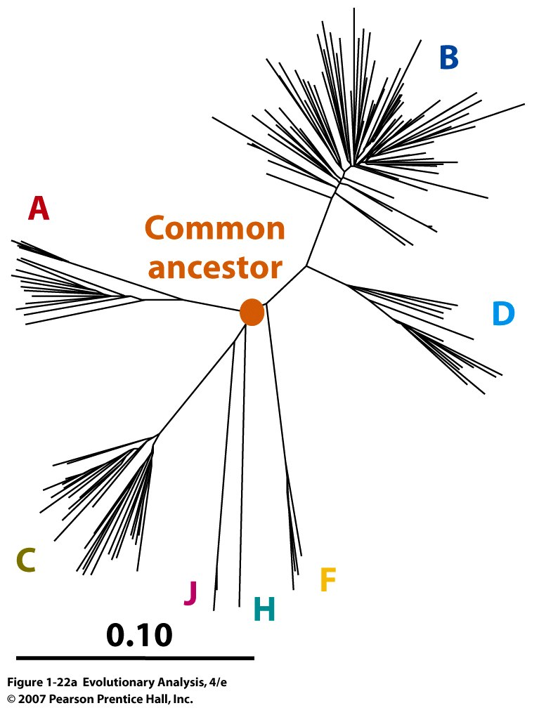
Group M HIV-1 Strains
Notes:
Figure 1.22a Dating the common ancestor of HIV-1 strains in group M using envelope proteins, M group most prevalent
An unrooted evolutionary tree for 159 group M HIVs. The tip of each twig represents a virion; the distance traveled from one tip to another represents the genetic difference between the two virions. The orange dot marks the common ancestor of all group M strains.
ABCD different strains

Slide 24
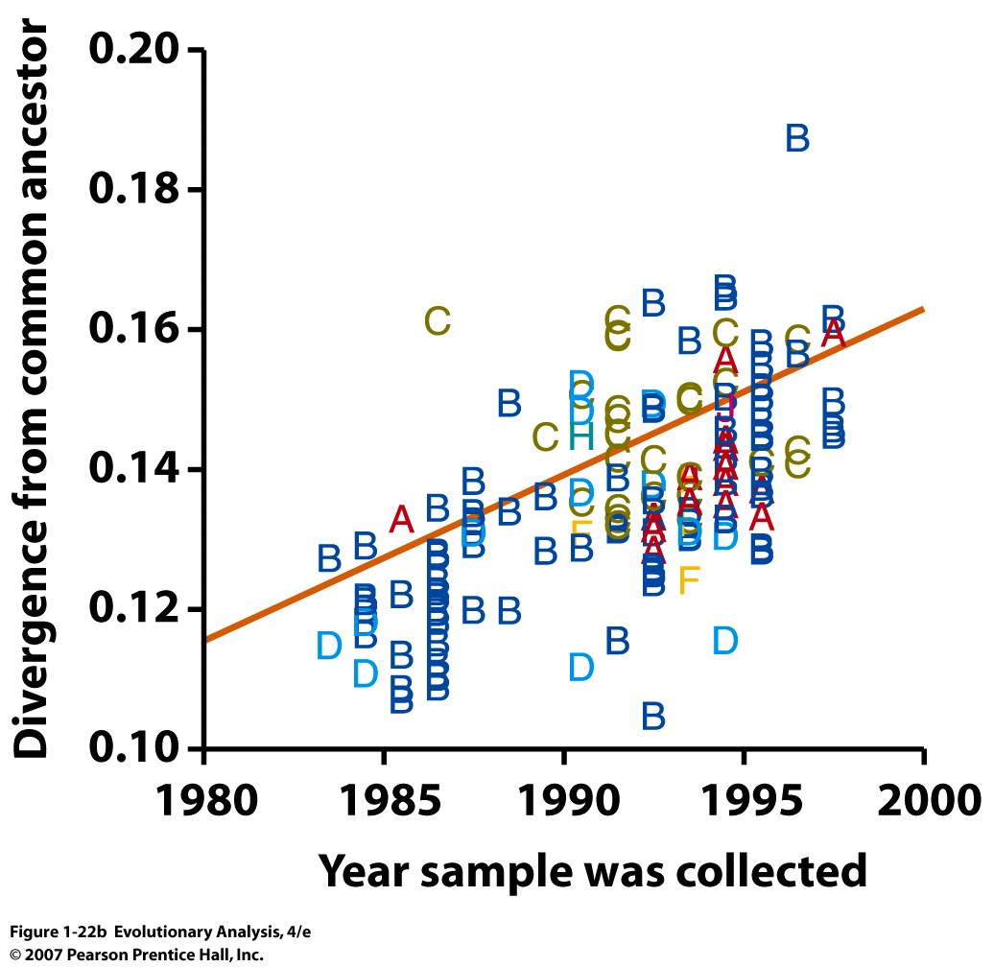
Notes:
Note that the difference in sequence among HIV viruses increases over time.
Descent with modification
Figure 1.22b Dating the common ancestor of HIV-1 strains in group M
(b) This scatterplot shows the genetic difference between each HIV sample in (a) versus the common ancestor as a function of the date the sample was collected. The statistical best-fit line is in orange.

Slide 25
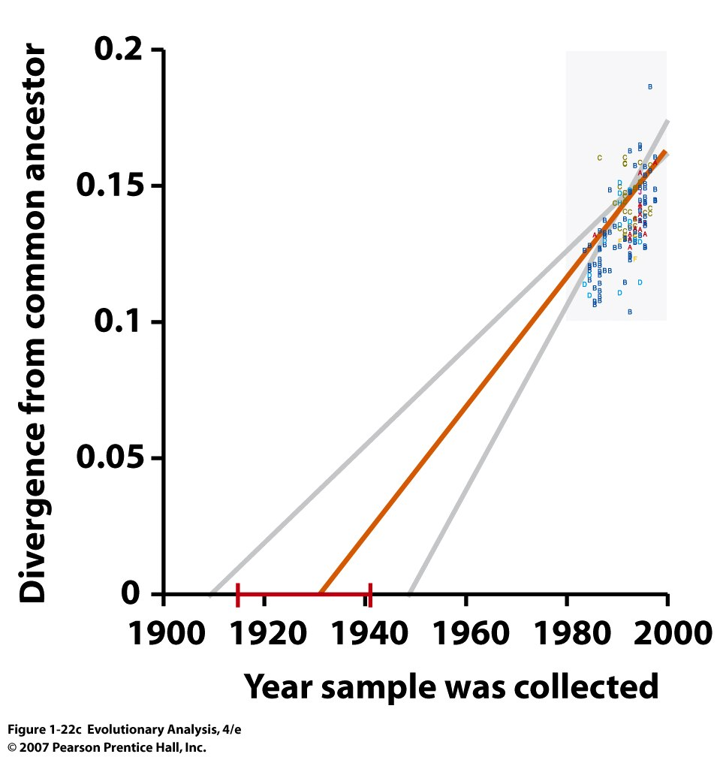
Notes:
Figure 1.22c Dating the common ancestor of HIV-1 strains in group M
(c) Extrapolating the best-fit line in (b) back to zero genetic difference gives an estimate of the date at which the common ancestor lived. From Korber et al. (2000). Used envelope proteins (gp60)

Slide 26
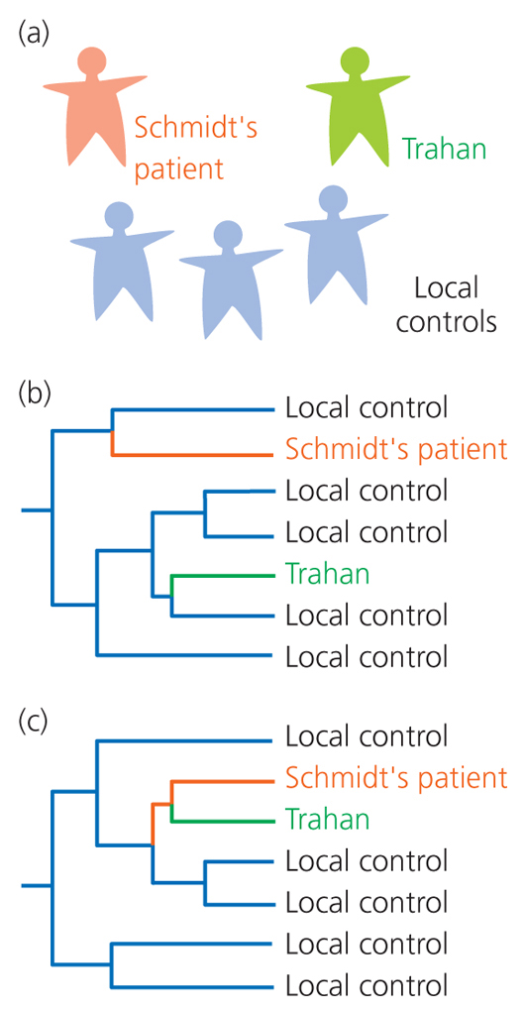
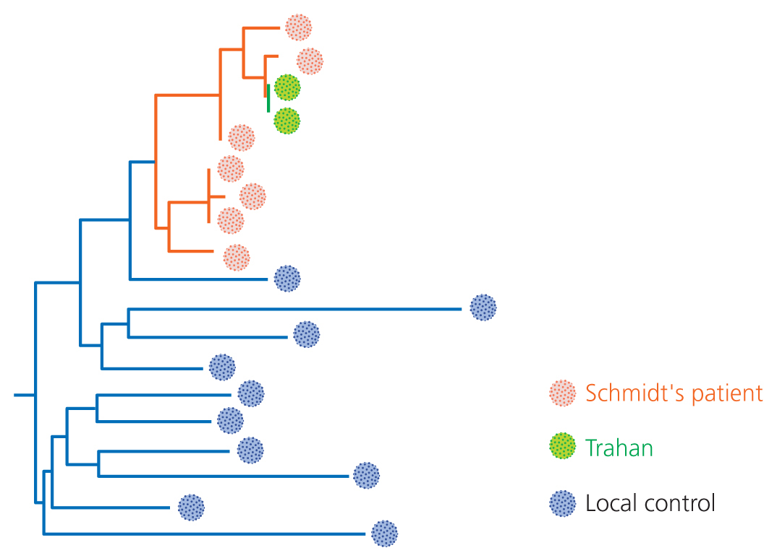
Innocent
Evidence
Guilty

Slide 27
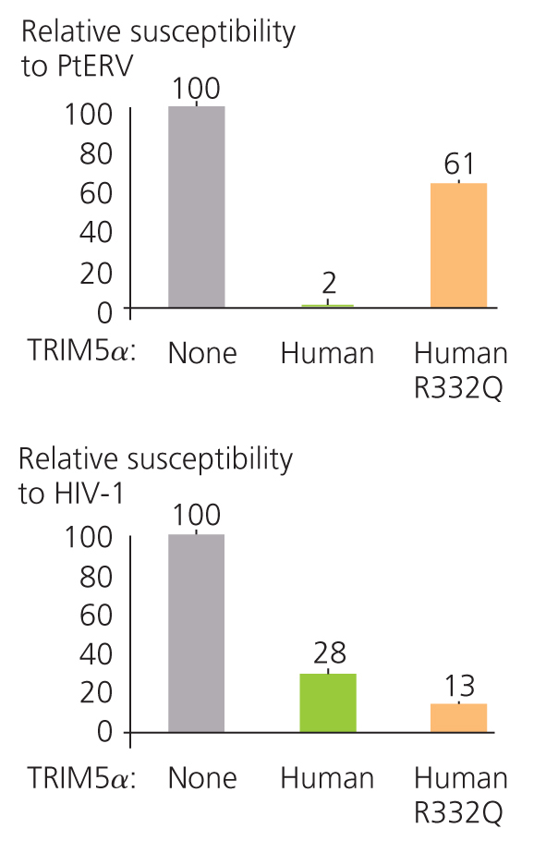
Why are humans susceptible to HIV??
TRIM5alpha = antiviral
protein
at position 332 of
protein glutamine
instead of arginine
Perhaps constrained by past evolutionary history

Slide 28
VIII. HIV is a good model to start us thinking in evolutionary terms:
Selective agents on host and disease
Source or origin of disease
Strategies to combat HIV
Highlights evolutionary theory:
Natural selection
Mutation
Gene Flow
Descent with Modification
Constraints from past evolution
?? Why does HIV kill its host??

